Slide 1
PLM Example
Demonstrates key relationships expressed in the MRM concerning programs, services, service outputs, outcomes, target groups and needs

Slide 2
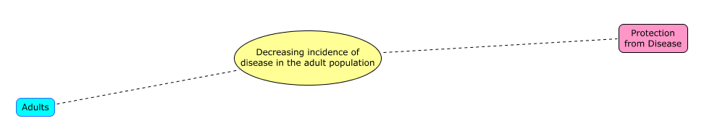
Outcome = a trend in the level of a recognized target group need, resulting from government action
Recognized
Need
Outcome
Target
Group
The government’s intent is a desirable trend. An undesirable trend is an unanticipated or accidental outcome.
Notes:
The government’s intent is a desirable trend. An undesirable trend is an unanticipated or accidental outcome.

Slide 3
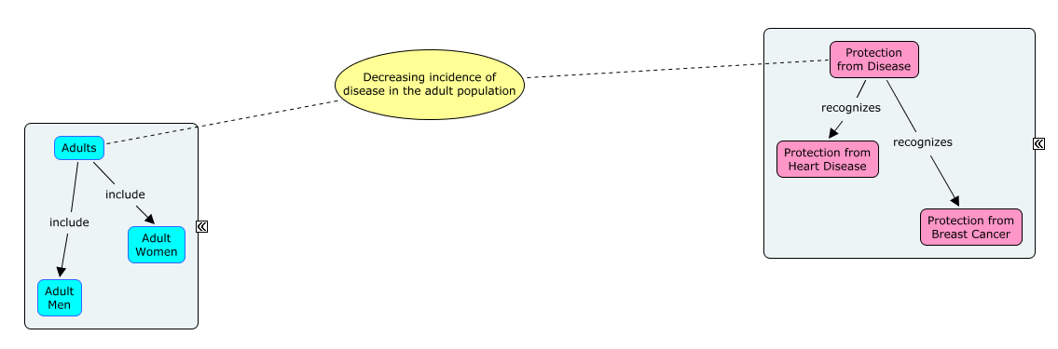
Target groups and recognized needs each form complex hierarchies
Recognized Needs
Model
Target Group
Model
Strictly speaking, target group and needs models form multiple inheritance networks, not hierarchies.
Notes:
Strictly speaking, target group and needs models form multiple inheritance networks, not hierarchies.

Slide 4
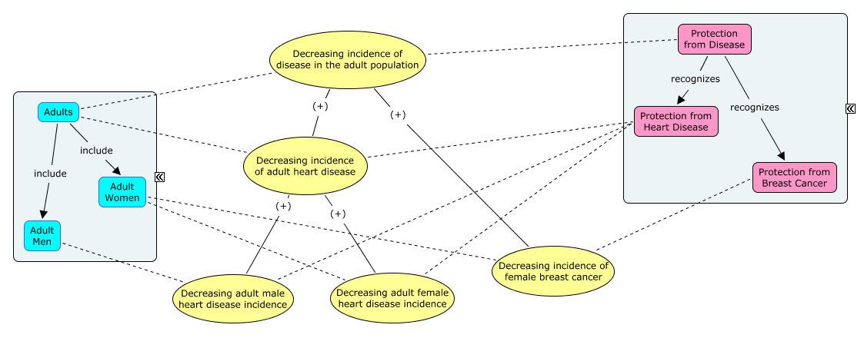
Outcomes measures are statistical population measures based on target group and need hierarchies
Some measures are direct and some are proxies. Defining outcomes this way ensures measures can be related to each other.

Slide 5
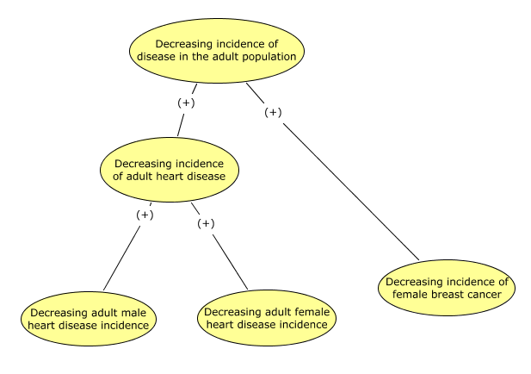
The outcomes hierarchy is the logical heart of the Program Logic Model (PLM)

Slide 6
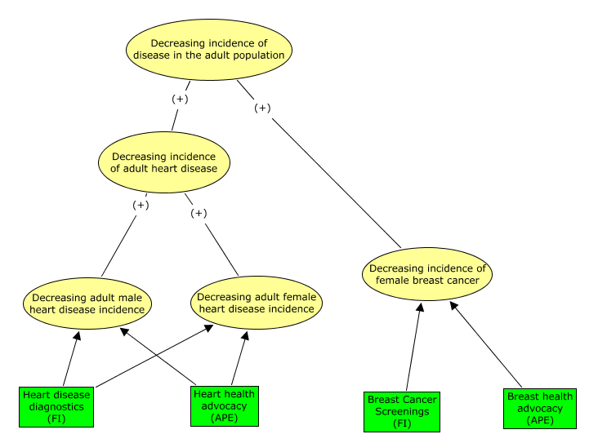
Adding service outputs to the PLM expresses the government’s hypothesis of cause and effect, to be proved (or not) with measures
Services are sometimes shown in the model, but not here for simplicity’s sake, and to emphasize the output as the essential cause.
Notes:
Services could be illustrated here, but are not for simplicity’s sake and to emphasize the output as the essential cause.

Slide 7
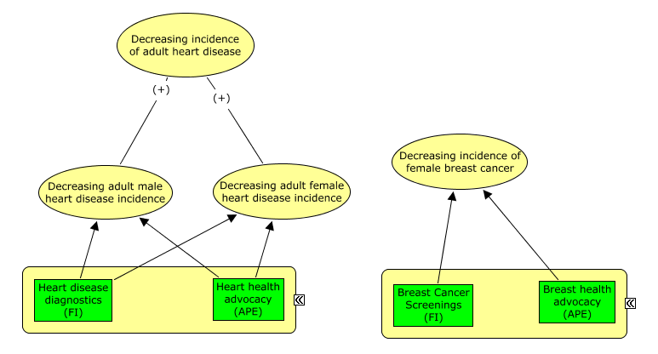
The PLM analyzes the limits of program accountability
Heart Health Program
Breast Health Program

Slide 8
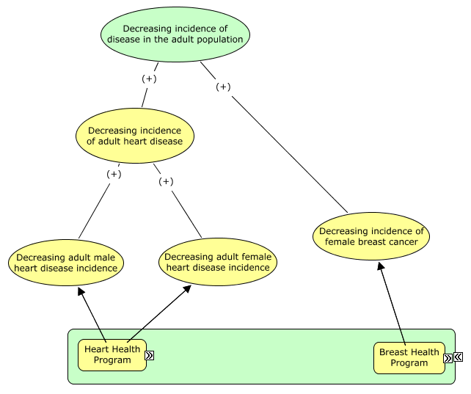
And helps to define program hierarchy…
Public Health Program

